Slide 1

Financial Management System
Nikhil Bhati | Sanchit Kalra | Ying Wang | Devika Krishnan | Vinod

Slide 2
Agenda
Problem Statement
Background
Objective
Dataset
Model Selection
Motivation
Scope
Methodology
Data Understanding and Preprocessing
Feature Engineering
Train/Test Data Splitting
Model Building and Hyperparameter Tuning
Business Impact Analysis
EDA
Model Evaluation
Key Output
Power BI Dashboard

Slide 3

Problem Statement
The rise in fraudulent transactions, coupled with outdated banking technologies, has led to substantial revenue losses for Finex. The primary challenge lies in detecting and preventing unauthorized transactions promptly. Current systems are ineffective in identifying fraudulent activities, leading to delayed response times and increased financial liabilities for the bank. The task at hand is to develop a machine learning model capable of detecting fraudulent transactions accurately and efficiently.
Motivation
In recent years, the proliferation of fraudulent transactions has presented a significant challenge for credit card companies, leading to substantial financial losses and eroding trust among customers. FinTech industries has been grappling with a surge in unauthorized transactions, resulting in severe revenue and profitability crises. Traditional banking systems are ill-equipped to swiftly detect and prevent these fraudulent activities, necessitating the adoption of advanced technologies such as machine learning.

Slide 4

Problem Statement
Scope
This project aims to develop a robust fraud detection system leveraging machine learning techniques to identify and prevent unauthorized transactions effectively. By analyzing historical transactional data, the goal is to build a model capable of accurately flagging fraudulent activities in real-time. The scope encompasses understanding the pipeline of typical transactions, conducting root cause analysis, and implementing a machine learning-based solution to mitigate financial losses.

Slide 5
Background
With the increasing prevalence of online shopping and electronic payments, the banking industry is witnessing a surge in fraudulent activities, particularly in credit and debit card transactions. Fraudsters are constantly devising sophisticated methods to exploit vulnerabilities in existing banking systems, resulting in substantial financial losses for both financial institutions and their customers. Traditional fraud detection methods, relying solely on rule-based systems and manual monitoring, are proving inadequate in thwarting these evolving threats.
Against this backdrop, financial service providers are recognizing the urgent need to adopt advanced technologies such as machine learning to bolster their fraud detection capabilities. Machine learning algorithms offer the promise of analyzing large volumes of transactional data, identifying patterns indicative of fraudulent behavior, and flagging suspicious activities in real-time. By leveraging the power of artificial intelligence, banks can enhance their ability to detect and prevent fraudulent transactions proactively, thereby safeguarding the interests of their customers and preserving the integrity of the banking system as a whole.

Slide 6
Objective
Understand the existing transaction pipeline and identify weaknesses susceptible to fraudulent activities.
Analyze historical transactional data to uncover patterns and trends associated with fraudulent transactions.
Develop and deploy a machine learning-based fraud detection system capable of real-time monitoring and flagging of suspicious activities.
Evaluate the performance of the fraud detection model using appropriate metrics and conduct a cost-benefit analysis to quantify potential savings for the bank.
Present findings and recommendations to relevant stakeholders, highlighting the financial impact and benefits of deploying the fraud detection system.

Slide 7
Dataset
The dataset contains transactional data from credit card transactions. It includes features such as transaction amount, merchant information, transaction timestamp, and whether the transaction is fraudulent or not (label). The dataset covers a period of time, spanning multiple months or years, to capture varying patterns and trends in transactional behavior. It is highly imbalanced, with fraudulent transactions representing a small percentage of the total transactions (e.g., less than 1%).
The Simulated Credit Card Transaction Dataset offers a comprehensive view of credit card transactions. Created using the Sparkov Data Generation tool by Brandon Harris, this dataset encompasses transactions from 1000 customers and 800 merchants. It includes both legitimate and fraudulent transactions, providing researchers and analysts with valuable insights into transactional behavior and patterns over the specified timeframe.

Slide 8
Methodology
Data Understanding and Preprocessing:
Data consists of 1,745,239 rows and 23 columns.
The trans_date_trans_time column was converted to datetime format for analysis.
Additional columns like trans_hour, trans_day_of_week, and trans_year_month were derived from trans_date_trans_time.
The dob column was converted to datetime to calculate the age of customers.
No missing values were found in the dataset.
EDA (Exploratory Data Analysis):
Histograms and count plots were used to analyze transaction amounts, categories, genders, states, jobs, and cities.
Notable insights:
Gas_transport category had the highest number of transactions, while traveling had the least.
Females conducted more transactions compared to males.
Fraudulent transactions were a minority, as expected.
Texas (TX) had the highest number of transactions among states, while Oklahoma (OK) had the least.
Film/video editors had the highest number of transactions among job categories.
Birmingham was the city with the highest number of transactions.
'fraud_killback LLC' appeared to be a significant agency for fraud detection.

Slide 9
Methodology
Feature Engineering:
Additional columns such as trans_hour, trans_day_of_week, trans_year_month, and age were derived for deeper analysis.
No highly skewed categorical variables were found.
Train/Test Data Splitting:
Data was split into training and testing sets using a 75/25 split ratio.
Independent variables (X) and the target variable (y) were defined accordingly.
Model Building and Hyperparameter Tuning:
Logistic Regression and Random Forest models were built.
Hyperparameter tuning was performed for the Random Forest model using GridSearchCV.
Best parameters for Random Forest: {'max_depth': 30, 'max_features': 'sqrt', 'min_samples_leaf': 1, 'min_samples_split': 2, 'n_estimators': 200}.

Slide 10
Methodology
Model Evaluation:
Performance metrics were calculated for each model, including accuracy, F1 score, precision, and recall.
Business Impact Analysis:
Class imbalance was addressed using SMOTE sampling, which significantly improved the model's ability to detect fraud.
Cost-benefit analysis could be performed using the model's predictions to assess potential financial losses due to fraud.

Slide 11
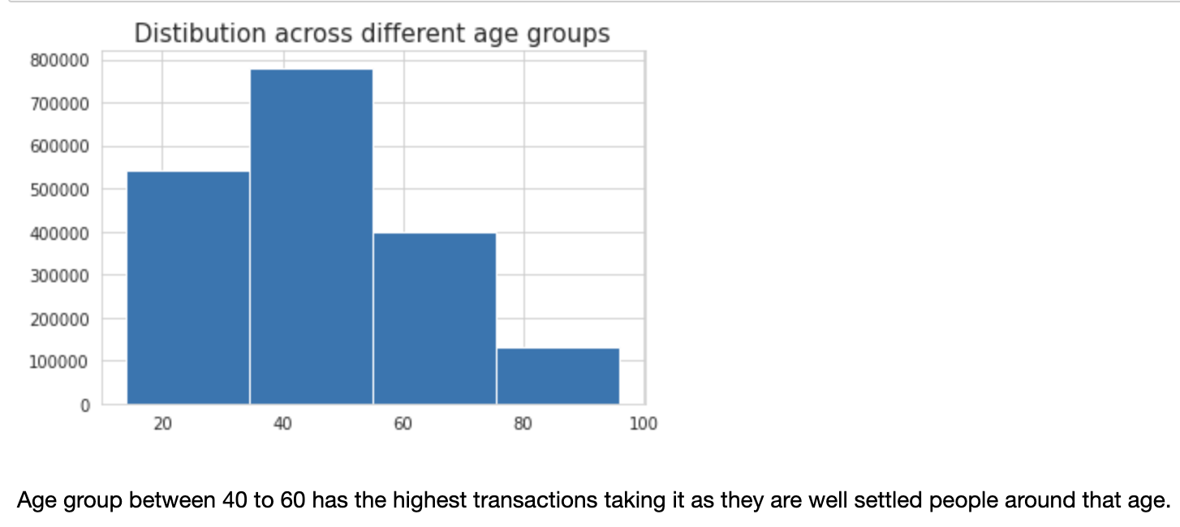
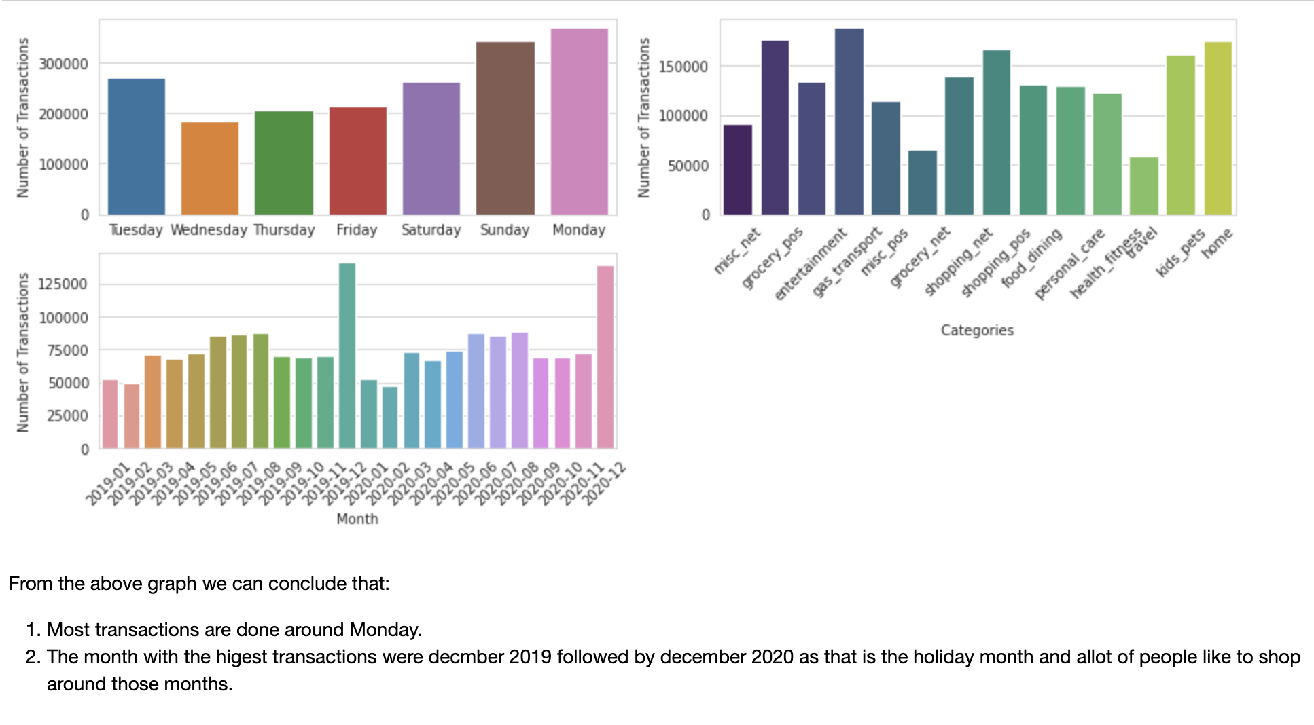
Output

Slide 12
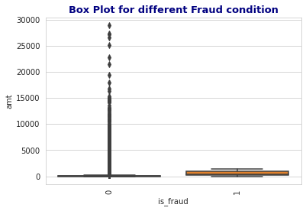
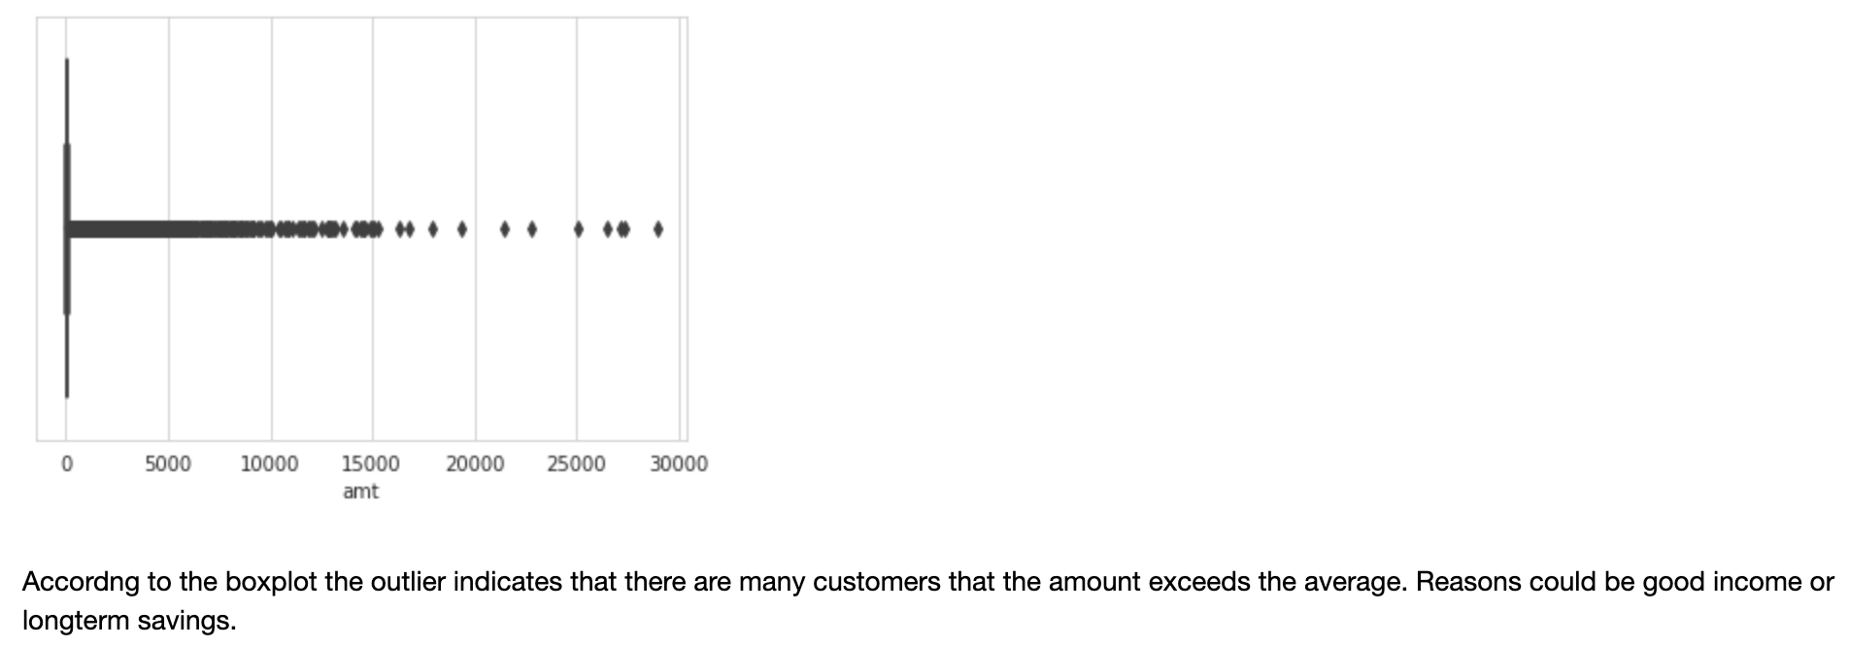
Output

Slide 13
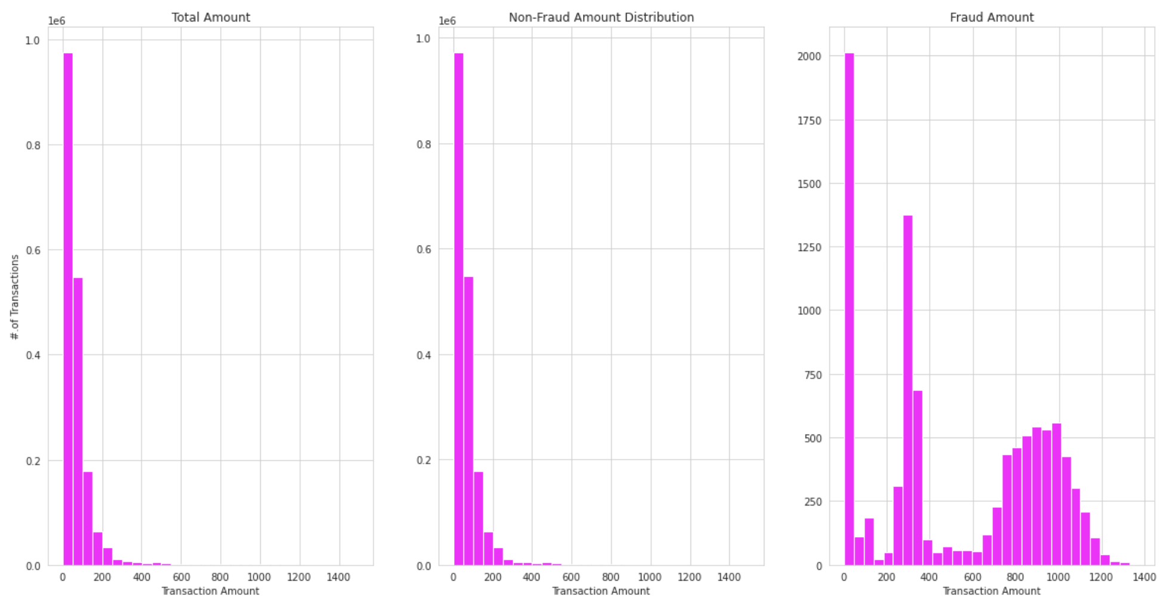
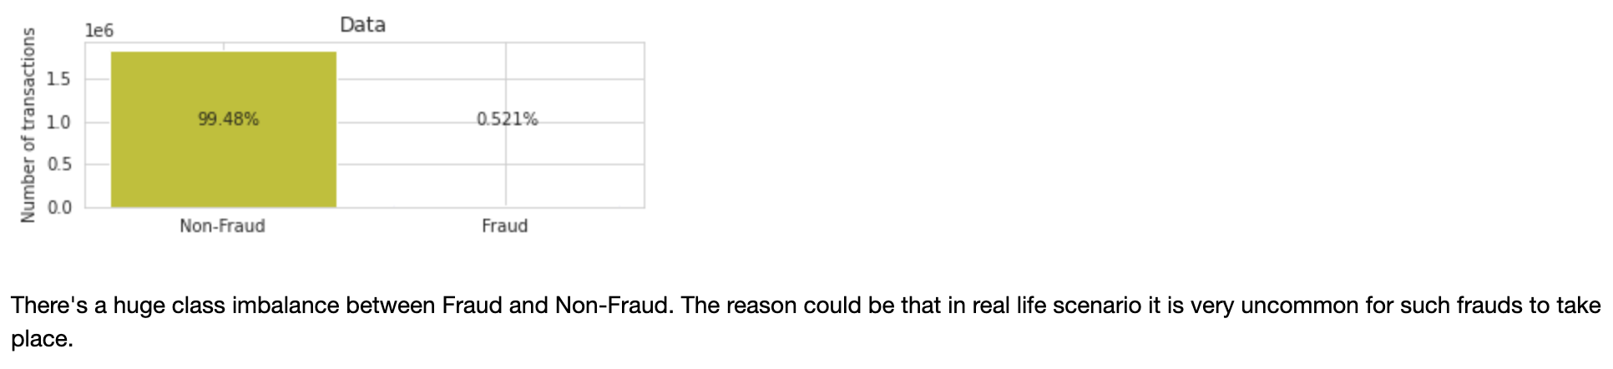
Output

Slide 14
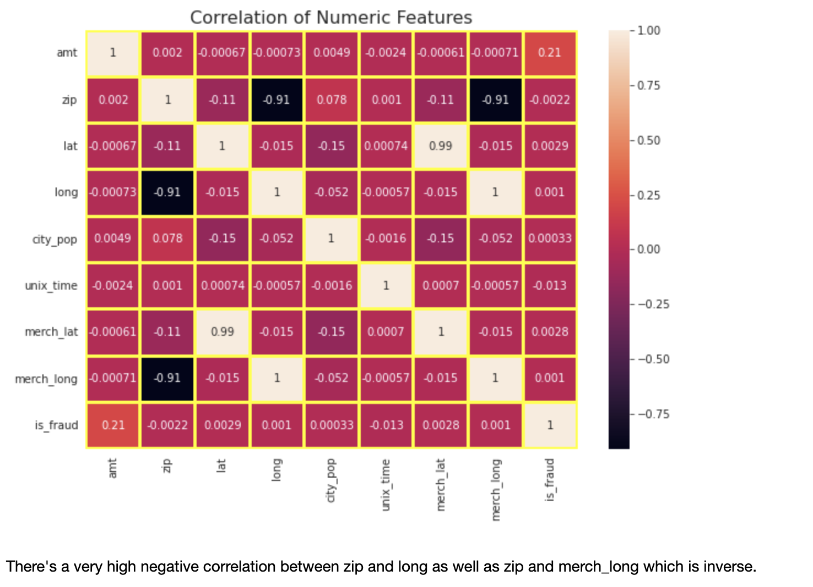
Output

Slide 15
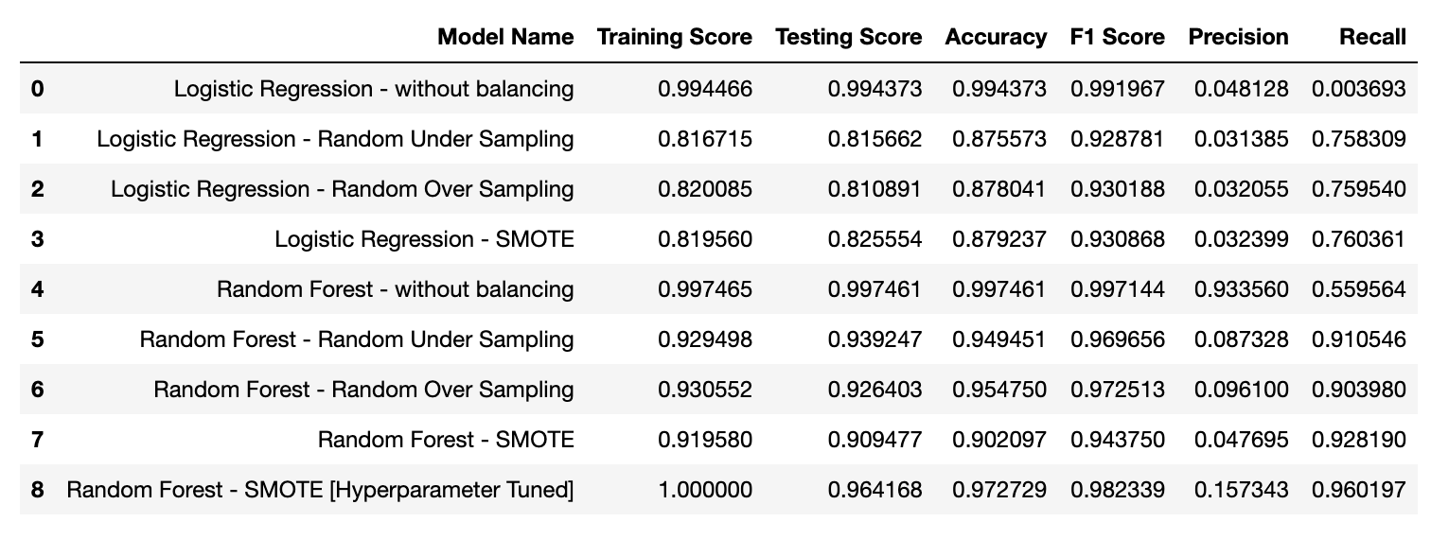
Model Selection
Even though it might not has the highest accuracy but the best model appears to be the Random Forest - SMOTE [Hyperparameter Tuned] model, as it has the highest accuracy, F1 score, precision, and recall among all the models listed. This indicates that the model performs well in terms of both overall accuracy and the balance between precision and recall.

Slide 16
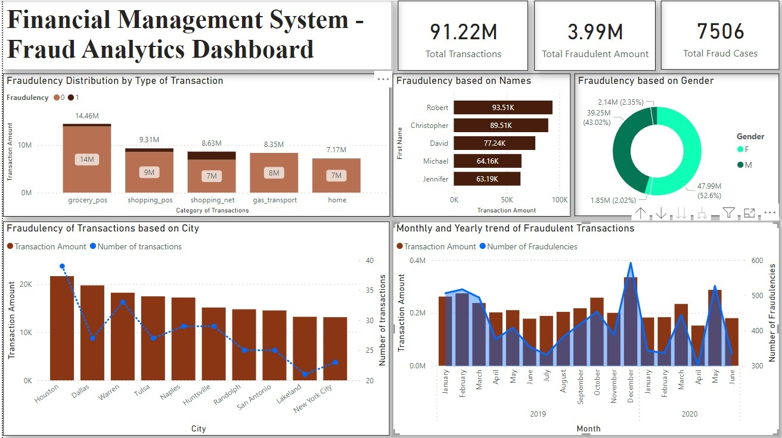
Power BI Dashboard

Slide 17

Link To Power Bi DashBoard
https://app.powerbi.com/links/xZDfK9SRLj?ctid=49bba7a4-424b-4070-a70e-886e9dd7caef&pbi_source=linkShare

Slide 18

Next Steps
Development of the front end interface and Collaborating with existing backend will be done in the next phase of the project

Slide 19

Thank you

